Slide 1
Western Resource Adequacy Program
February 15, 2023

Slide 2
Solving a Problem
Resource Adequacy is currently conducted on utility-by-utility basis under individual IRPs or other local planning processes
No standardized method for measuring reliability risk or capacity contribution of resources
Utilities often must make broad assumptions about regional capacity availability that may not be accurate
Implements a binding forward showing framework that requires entities to demonstrate they have secured their share of the regional capacity need for the upcoming season
Implements a binding operational program that obligates members with calculated surplus to assist participants with a calculated deficit on the hours of highest need
Leverages the binding nature of the operational program, together with modeled supply and load diversity, to safely lower the requirements in the forward showing and help inform resource selection for the region, driving investment savings for members and their end use customers
Notes:
Rebecca

Slide 3
WRAP Participation
Voluntary participation in the program by the Load Responsible Entity (LRE)
Primary entity responsible for meeting RA requirements —focus of program rights, responsibilities and compliance
Sign Western Resource Adequacy Agreement (WRAA) (pro forma agreement under the WRAP Tariff) to commit
Fund the costs of administering the program and sits on RA Participant Committee (RAPC)
While joining is voluntary, once an LRE has joined, compliance is mandatory

Slide 4
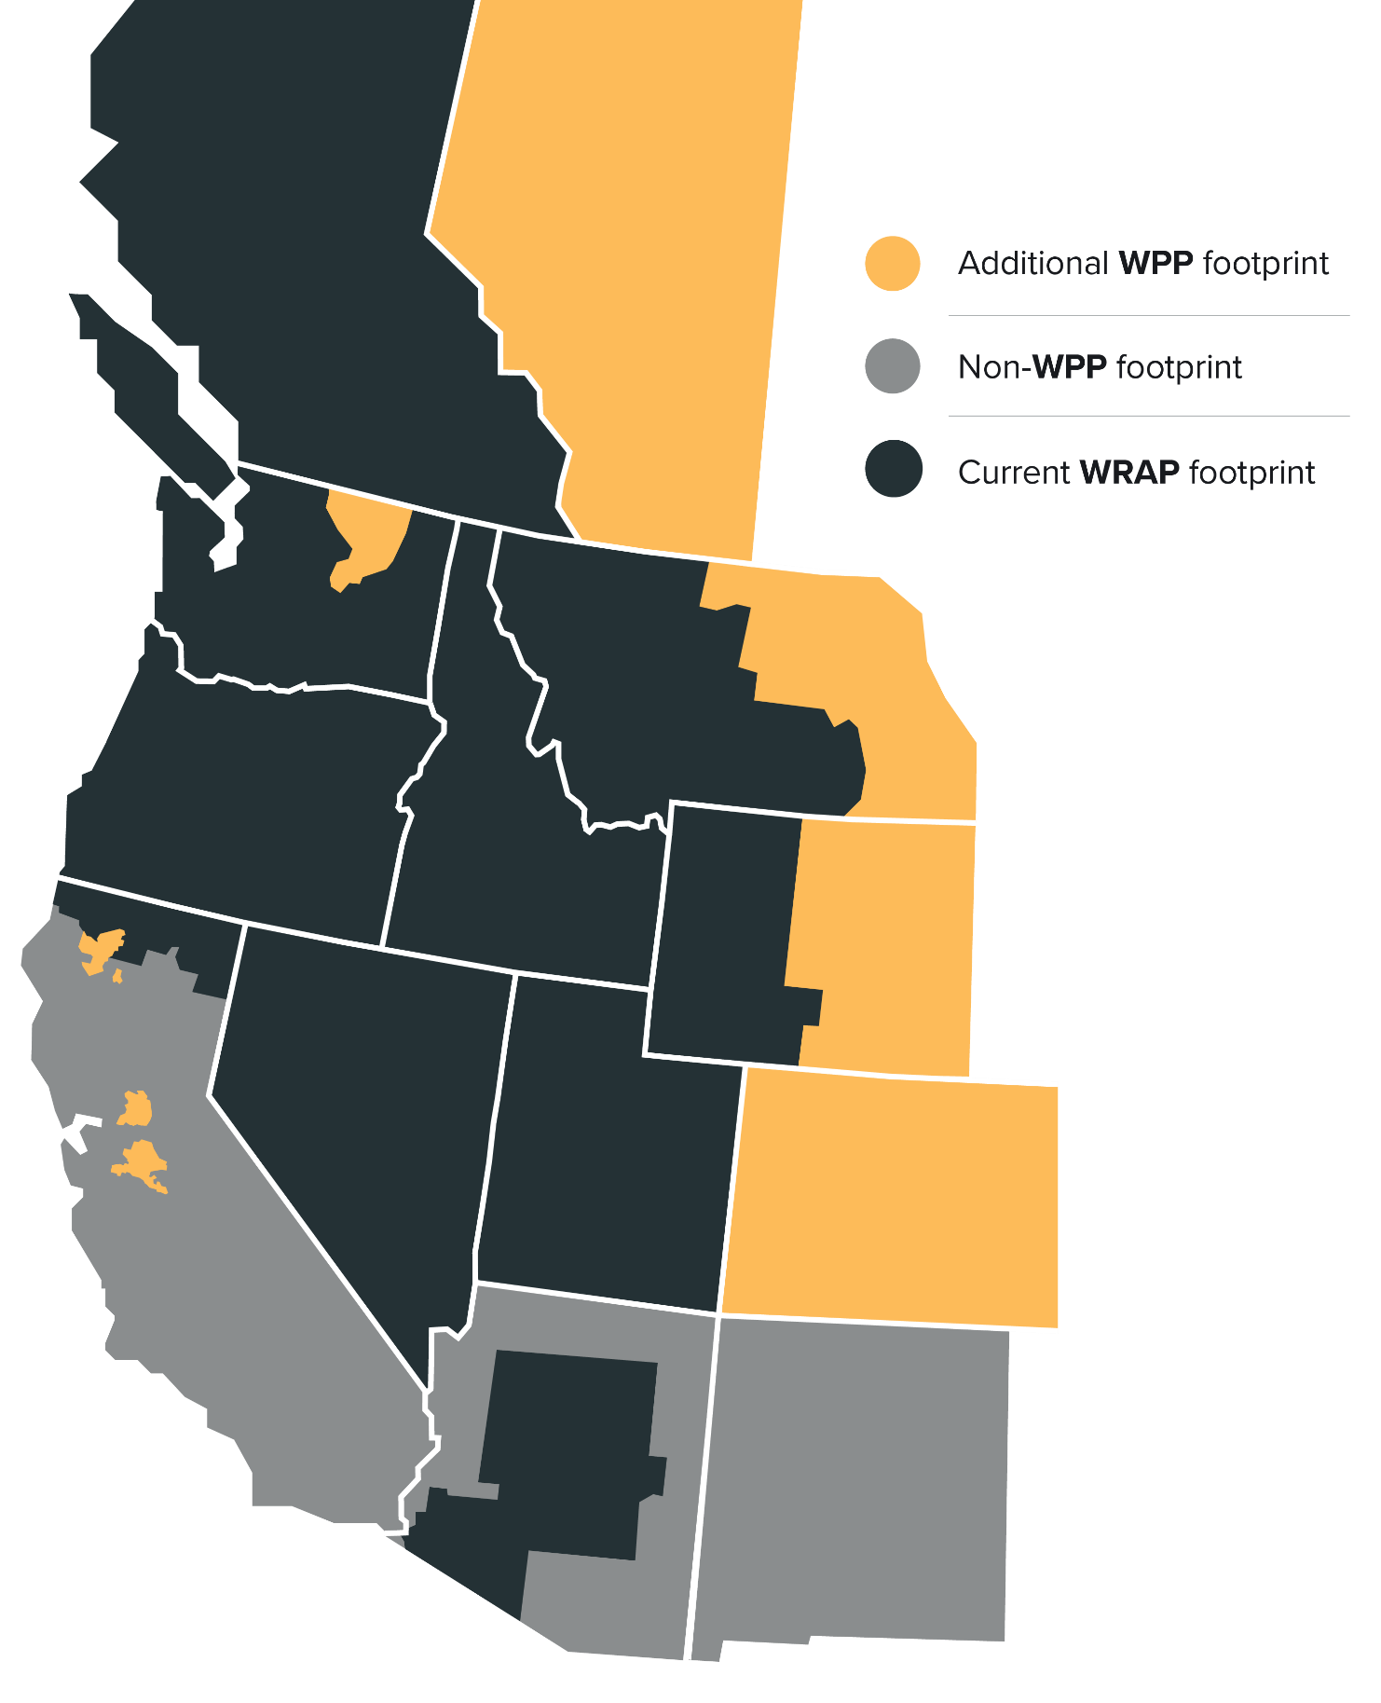
Current Participants Arizona Public Service Avista Bonneville Power Administration Calpine Chelan PUD Clatskanie PUD Eugene Water & Electric Board Grant PUD Idaho Power NorthWestern Energy NV Energy PacifiCorp Portland General Electric Powerex Puget Sound Energy Salt River Project Seattle City Light Shell Energy Snohomish PUD Tacoma Power
Industry-driven initiative for regional approach to help ensure resource adequacy in light of changing resource composition and increased resource uncertainty
Estimated peak winter load of 65,122 MW and summer load of 66,768 MW
Implemented through bilateral transactions under existing frameworks
Also – in response to feedback from participants, NWPP is now doing business as Western Power Pool (WPP)
Notes:
Rebecca

Slide 5
Program Design Overview Forward Showing Program
Determine Program Capacity Requirement
Determine Resource Capacity Contribution
Compliance Review of Portfolio
Two Seasons
Winter Season: November – March 15
Summer Season: June – September 15
Annual Assessment
PO performs LOLE studies 2-5 years before Binding Season
Forward Showing
Participant submits completed FS workbook 7 months before each (Winter and Summer) Binding Season
PO notifies Participant of any deficiencies 60 days after FS submission deadline
Participant must cure deficiencies within 60 days after PO notice (120 days after initial FS deadline, if later) to avoid deficiency charge

Slide 6
Program Design Overview Operations Program
FS Expectations
Operational Reality
Sharing Requirement
Evaluates participants operational situation relative to Forward Showing assumptions (for load, outages, VER performance)
PO runs advisory sharing calculation beginning 7 days prior to operating day
Obligates participants with calculated surplus to assist participants with a calculated deficit on the hours of highest need
Deficiency forecast on day before Operating Day (Preschedule Day) establishes Holdback Requirement for surplus participants
Obligation is allocated pro-rata to surplus participants
Surplus Participant that fails to provide assigned Energy Deployment must pay Energy Delivery Failure Charge
Waivers will be available for specific circumstances
𝑺𝒉𝒂𝒓𝒊𝒏𝒈 𝑹𝒆𝒒𝒖𝒊𝒓𝒆𝒎𝒆𝒏𝒕 = [𝑷𝟓𝟎 + 𝑷𝑹𝑴 −
𝜟 𝑭𝒐𝒓𝒄𝒆𝒅 𝑶𝒖𝒕𝒂𝒈𝒆𝒔 +
𝜟𝑹𝒐𝑹 𝑷𝒆𝒓𝒇𝒐𝒓𝒎𝒂𝒏𝒄𝒆 +
𝜟𝑽𝑬𝑹 𝑷𝒆𝒓𝒇𝒐𝒓𝒎𝒂𝒏𝒄𝒆] –
[𝑳𝒐𝒂𝒅 𝑭𝒐𝒓𝒆𝒄𝒂𝒔𝒕 + 𝜟𝑪𝑹 + 𝑼𝒏𝒄𝒆𝒓𝒕𝒂𝒊𝒏𝒕𝒚]

Slide 7
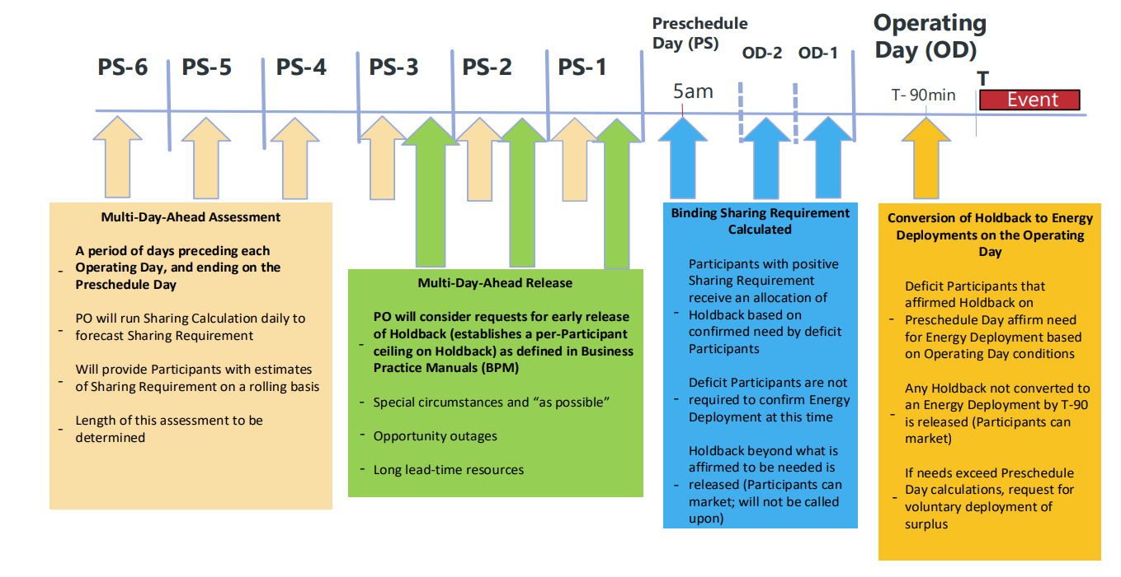
Operations Program Timeline

Slide 8
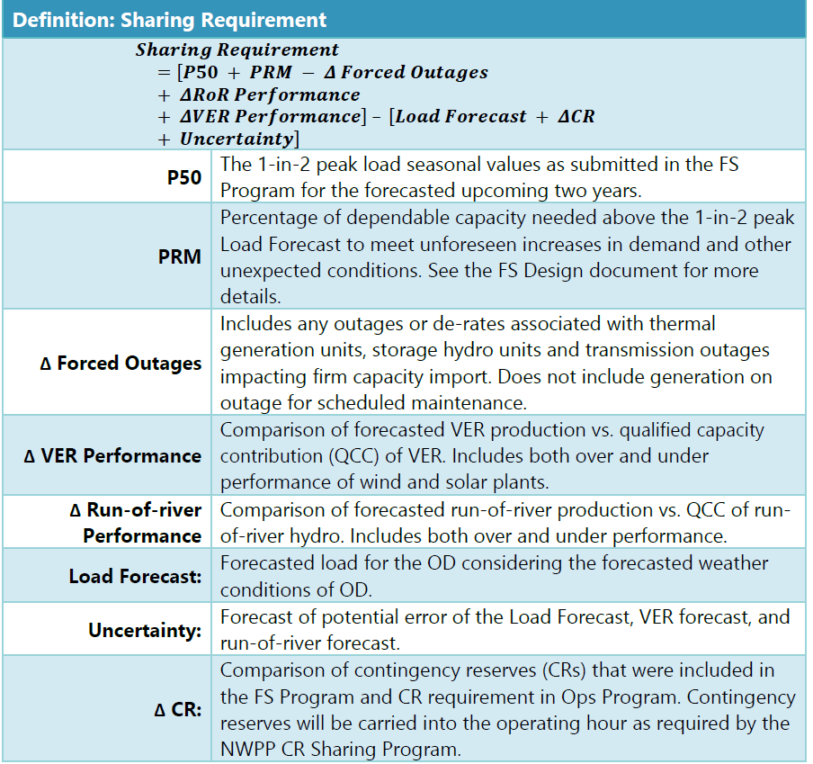
Operational Program

Slide 9
Transition Timeline
Non-Binding Forward Showing
Winter 22-23, Summer 23, Winter 23-24, Summer 24, Winter 24-25
Transition Seasons (Ops and FS)
Summer 25, Winter 25-26, Summer 26, Winter 26-27, Summer 27, Winter 27-28
Summer
Summer
Summer
Summer
Summer
Summer
Summer
2022
2023
2024
2025
2026
2027
2028
2029
Winter
Winter
Winter
Winter
Winter
Winter
Winter
Winter
Non-Binding Operations Program
Summer 23 (trial – will include testing scenarios), Winter 23-24, Summer 24, Winter 24-25
Binding Program Without Transition Provisions
Summer 28 and all seasons following
Notes:
Non-Binding FS Seasons: Winter 22-23, Summer 23, Winter 23-24, Summer 24, Winter 24-25
Non-Binding Ops Seasons: Summer 23 (trial - will include testing scenarios), Winter 23-24, Summer 24, Winter 24-25
Transition Seasons: (Ops + FS): Summer 25, Winter 25-26, Summer 26, Winter 26-27, Summer 27, Winter 27-28
Binding Program Without Transition Provisions: Summer 28 and all seasons following

Slide 10
What’s happening in 2023
Continued Program Administration
Business Practice Development: review and approval of first set of business practices
Retaining current staff and hiring 2-3 new staff
Continuing to develop stakeholder engagement structure and technology
Facilitation of Participant and stakeholder meetings
Program Operator work
Non-Binding Forward Showings: for Winter 2023-24, Summer 2024; data requests for updated modeling (Jan 2023)
Ops Program set up: program trials Summer 2023, first non-binding Winter 2023-24
Governance standup
Seating independent Board of Directors – a Nominating Committee worked through 2022 to identify the candidates
Fully empowered Program Review and Nominating Committees

